Slide 1
Statistics For Data Science
DTSC 620 Fall 2022
Instructor
Kiran Balagani, Ph.D.
kbalagan@nyit.edu
Teaching Assistant
Mr. Pranadeep Potti (mpotti@nyit.edu)

Slide 2
Agenda
Term Paper Option
Previous Lecture
Introduction to Probability
Bayes Decision Theory
Bayes Classification Rule
Today’s Lecture
Expected Loss
ROC Analysis
Base Rate Fallacy

Slide 3
Important Dates and Deadlines
Midterm Exam (Oct. 17th/24th, class time)
Final Exam (December 19th, class time)
Project Assignment 1 (~3rd/4th week of Oct.)
Project Assignment 2 (~3rd/4th week of Nov.)
Term Paper? (~1st week of Dec.)
Additional homework, opinion papers, presentations will be announced

Slide 4
Previous Lecture

Slide 5
CLASSIFICATION

Slide 6
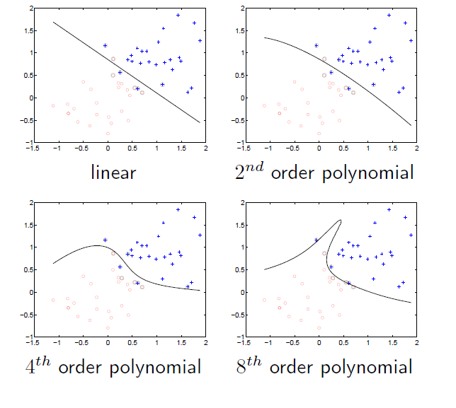
Classification

Slide 7
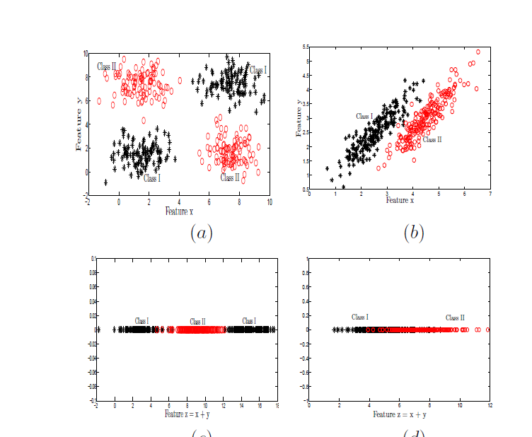
Classification

Slide 8
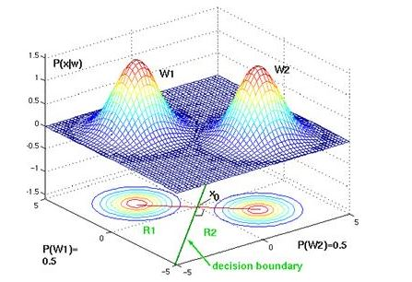
Classification

Slide 9
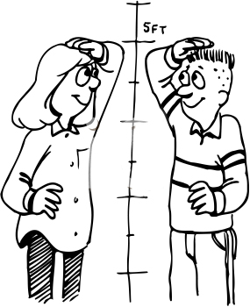





Decision Theory – Classification Problem

Slide 10

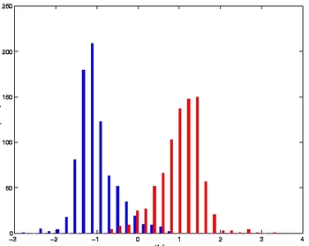



Decision Theory – Estimation (Inference)
Training by estimating probabilities
Height

Slide 11

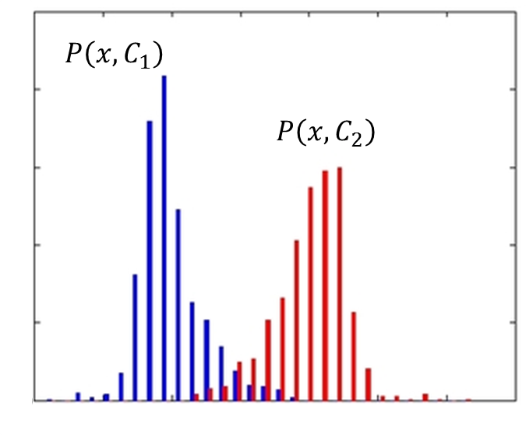
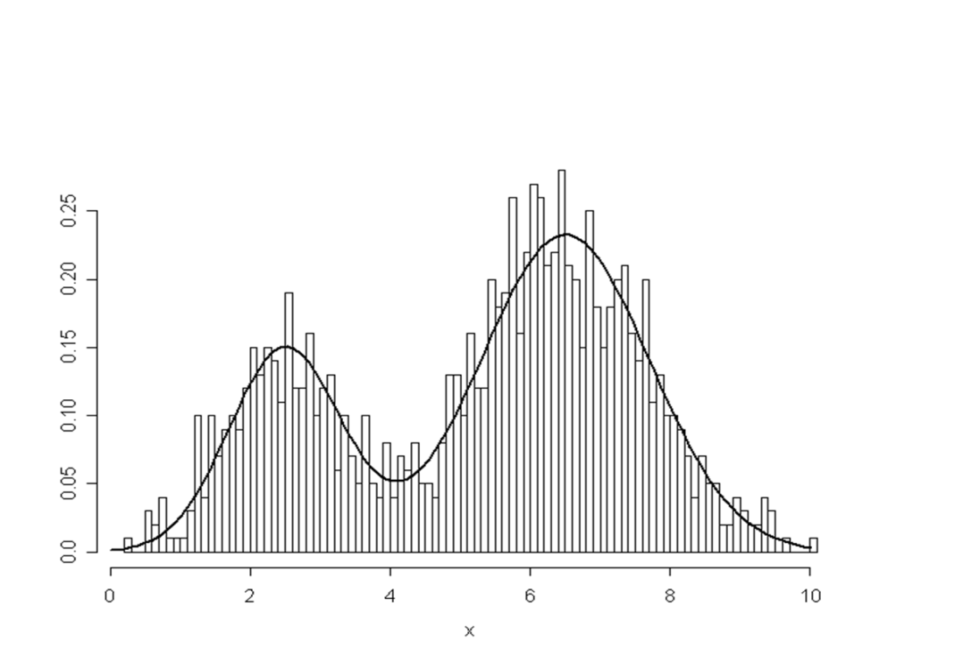
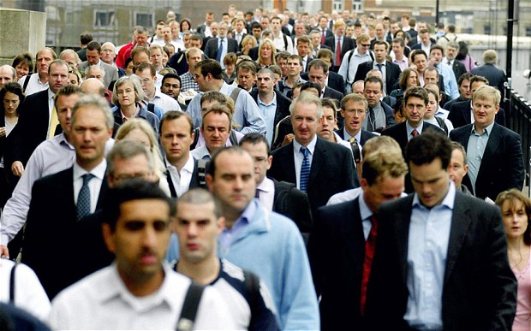
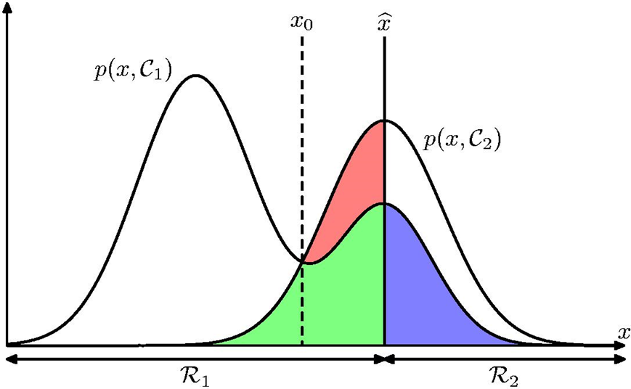

Slide 12



Minimum Misclassification Rate

Slide 13

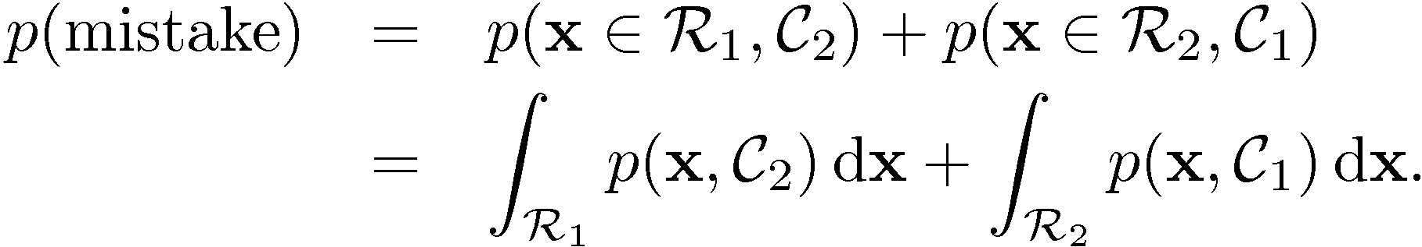
Minimum Misclassification Rate

Slide 14
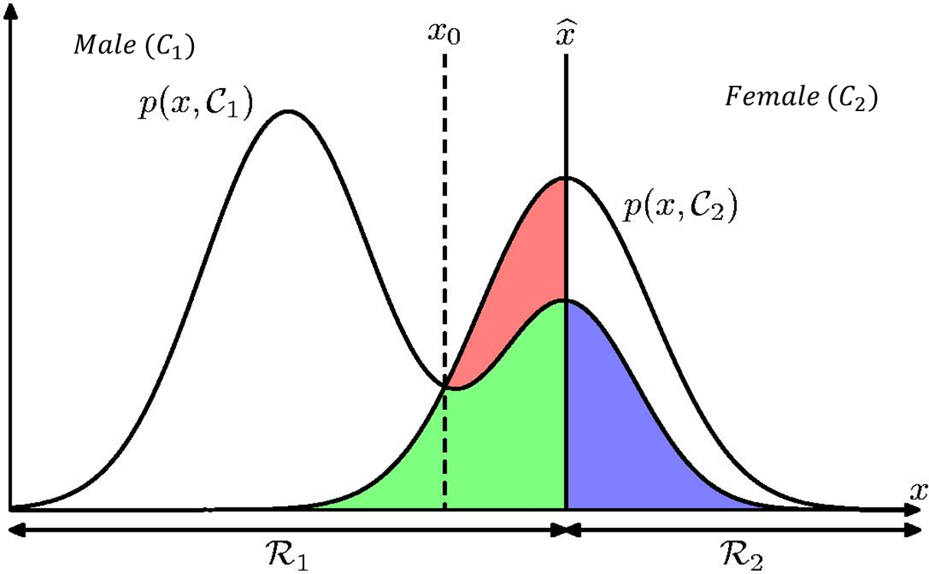


Bayes Classification Rule

Slide 15
Using Bayes Classification Rule to Predict the Class of a Feature Vector

Slide 16
Problem Statement
U₁ and U₂ are two classes
F is a feature vector
We can get the following information from training data
P(F, U₁)
P(F, U₂)
Now, given a test feature vector F’, to which class does this vector belong to?

Slide 17
Problem Example
U₁ and U₂ are two classes
F is a binary-valued feature vector called <f₁>
We are given the following information (training data)
P(f₁= 0, U₁) = 0.4 and P(f₁= 1, U₁) = 0.2
P(f₁= 0, U₂) = 0.1 and P(f₁= 1, U₂) = 0.3
Given a test feature vector f’₁= 0, to which class does f’₁ belong to?

Slide 18
Problem Solution
Given test feature vector f’₁= 0
Step 1: Find the joint probability between the test feature vector and each class
P(f’₁= 0, U₁) = 0.4
P(f’₁= 0, U₂) = 0.1
Step 2: Apply Bayes classification rule
If P(f’₁= 0, U₁) > P(f’₁= 0, U₂), f’₁ belongs to U₁ else U₂
According to the above rule
f’₁ = 0 belongs to U₁ (because 0.4 > 0.1)

Slide 19
Worksheet

Slide 20
Today’s Lecture

Slide 21
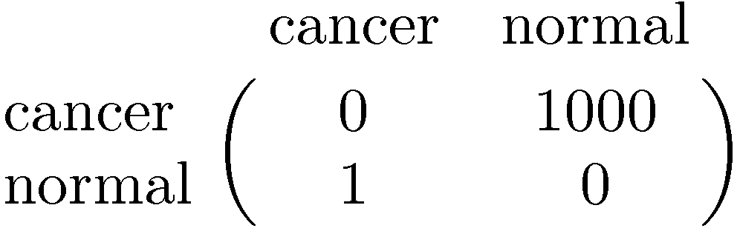
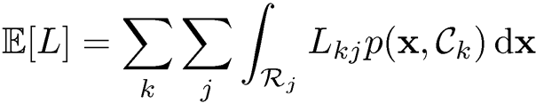
Minimum Expected Loss
Example: classify a medical image as ‘cancer’ or ‘normal’
Decision
Truth

Slide 22
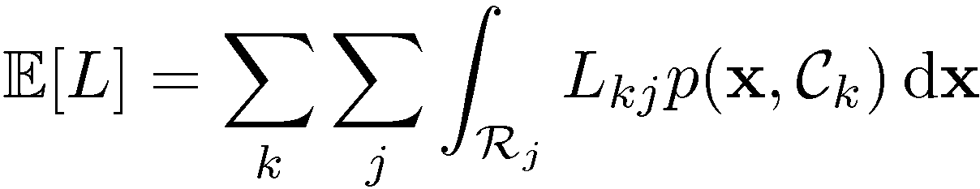

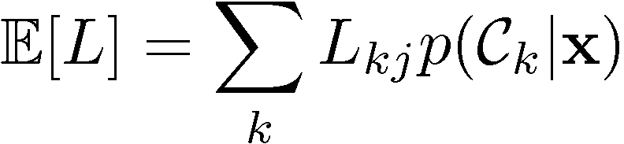
Minimum Expected Loss
Regions are chosen to minimize

Slide 23
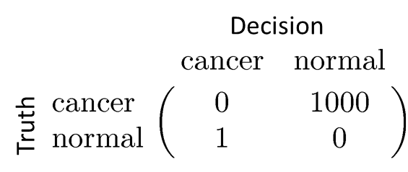

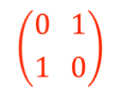




Is Bayes classification rule optimal for 0-1 loss?
1
Yes

Slide 24
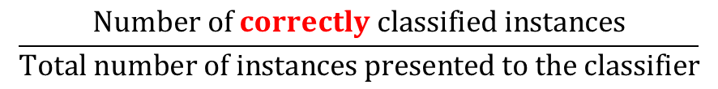
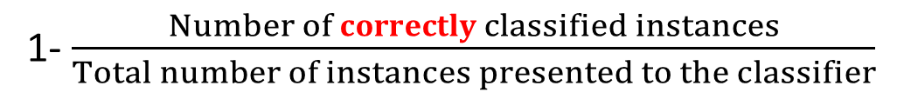
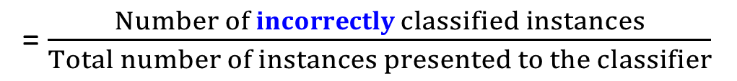
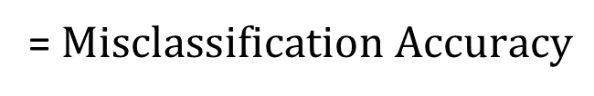
Classification Accuracy

Slide 25
Receiver Operating Characteristic Curve

Slide 26
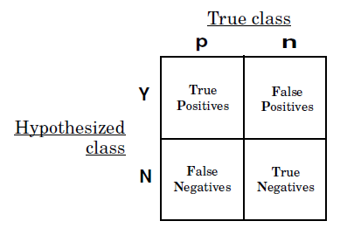

Slide 27
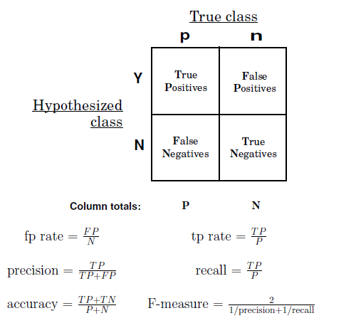

Slide 28
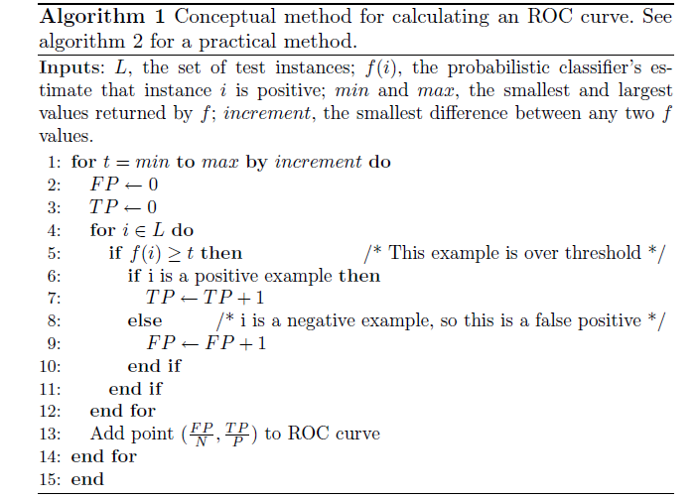

Slide 29
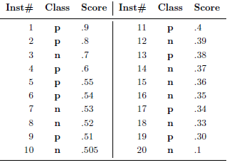

Slide 30
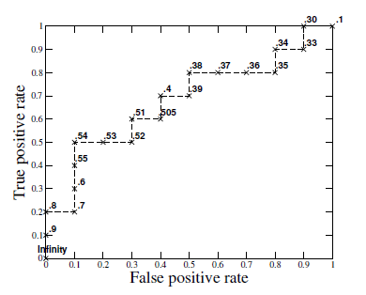

Slide 32
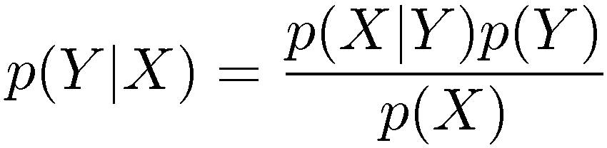
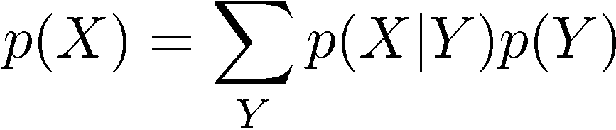
Bayes’ Theorem
posterior ∝ likelihood × prior

Slide 33
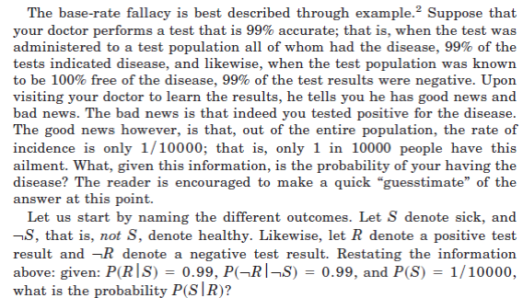

Slide 34


Slide 35
